Slide 1
RUNGTA COLLEGE OF DENTAL SCIENCES AND RESEARCH
Rationale of Endodontics
DEPARTMENT OF CONSERVATIVE DENTISTRY AND ENDODONTICS

Slide 2
Specific learning Objectives
At the end of this presentation the learner is expected to know ;
Core areas* | Domain ** | Category #
Introduction | Cognitive | Must know
Definitions | Cognitive | Must know
Classifications | Cognitive | Must know

Slide 3
Contents
INTRODUCTION
INFLAMMATION
Definition
Causes
Signs and Symptoms
Cells of inflammation
Inflammatory process
Tissue change
Periradicular manifestation
Repair
ENDODONTIC IMPLICATION

Slide 4
INTRODUCTION
INTRODUCTION:
The term “Rationale” can be defined as the fundamental reason or the rational basis for a procedure.
The rationale for endodontic therapy is based on the belief that a natural tooth function more efficiently and comfortably than a bridge, partial denture or an implant tooth.
Endodontic therapy allows the removal of vital or necrotic pulp from the canal system of an infected tooth and replaced by an inert filling material. This is mainly done to prevent extension of the disease from the pulp into the periapical tissues.

Slide 5
INFLAMMATION:
Definition: Can be defined as a local physiologic response of a living tissue to injury. The main objective of inflammation is to destroy the irritant causing tissue changes and bring back the tissue to a normal form and function.
Mediators of inflammation:
The agents that cause the changes in inflammation, the alterations in the blood vessels, the escape of proteins and cells into the tissues, and the change in the tissue – are called the mediators of inflammation.
The initiated, transient vasoconstriction in due to the direct stimulation of the blood vessels and the flare is caused by an/ or on reflex.
“Nerves are not necessary for the inflammatory process.” Inflammation develops normally in derivated tissue, except that the flow is absent. Nerves may play some part in modifying the severity of the vascular change, but in most circumstances their effect is slight.

Slide 6
Agents causing inflammation:
a. Physical agents: Heat, cold, mechanical trauma as in sports injuries, bruxism, accidental exposure during cavity preparation, rapid tooth movement during orthodontic treatment.
b. Chemical agents: ZnPO₄, Silicate, acid etching agents etc.
c. Infection agents: Bacterial, Virus, Parasites.
d. Immunological agents: Cell mediated reaction antigen – antibody, reaction.
Factors modifying the inflammatory respond
Host resistance
Intensity
Duration
Virulence of irritant / microorganism (pathogenicity of stimulus).

Slide 7
Symptoms of inflammation:
According to Roman hunter Celcus in 1st century A.D. typical signs of inflammation can be witnessed.
1. Dolar (Pain): Caused by the action of cytotoxic agents released from humoral, cellular and microbial elements of the nerve endings.
2. Tumor (Swelling): Produced by infiltration of macromoleculars and fluids into the affected tissues.
3. Rubor + Color (Redness + Heat): Produced by vasodilatation of the vessels and the rushing of blood to the affected tissues.
4. Loss of function: was later added by Verchow resulting of from changes in the affected tissues

Slide 8
Cells of inflammation:
Granulocytes Agranulocytes
- Neutrophils - Lymphocytes
- Eosinophils - monocytes
- Basophils
The main cells of acute inflammation are poly morphonuclear neutrophil (PMN’s).

Slide 9
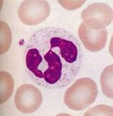
PMNs :
First cells to migrate from the vessels
Present at the acute/ early site of inflammation.
Phagocytose bacteria, fibrin, cellular debris.
Attracted to the area of inflammation by the chemotactic factors.
Die when the Ph falls below
6.5 in the site, due to
production of lactic acid in
the site,
PMNs with the product of cellular
lyses & debris are the principles
constituents of the pus.

Slide 10
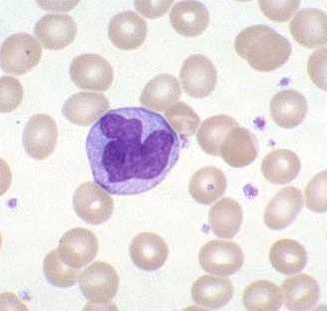
Macrophages
Derived from the circulating monocytes, immature monocytes in extra vascular area differentiate into Macrophages.
Phagocytic in nature.
Ingest cellular debris,microorg.
Secrete- lysosomal enzymes,
complement proteins
& prostaglandins.
Ingest, process & degrade
the antigen before they are
presented to the lymphocytes

Slide 11
Lymphocytes
Small Lymphocytes appear in the chronic inflammation.
T- cells – responsible for cell mediated immunity,
- stimulated by an antigen
- release chemical mediators - lymphokines (can be macrphages, PMNs)
- derived from thymus
B- cells- when activated by antigen are called as plasmoblasts & memory B cells. derived from bone marrow

Slide 12
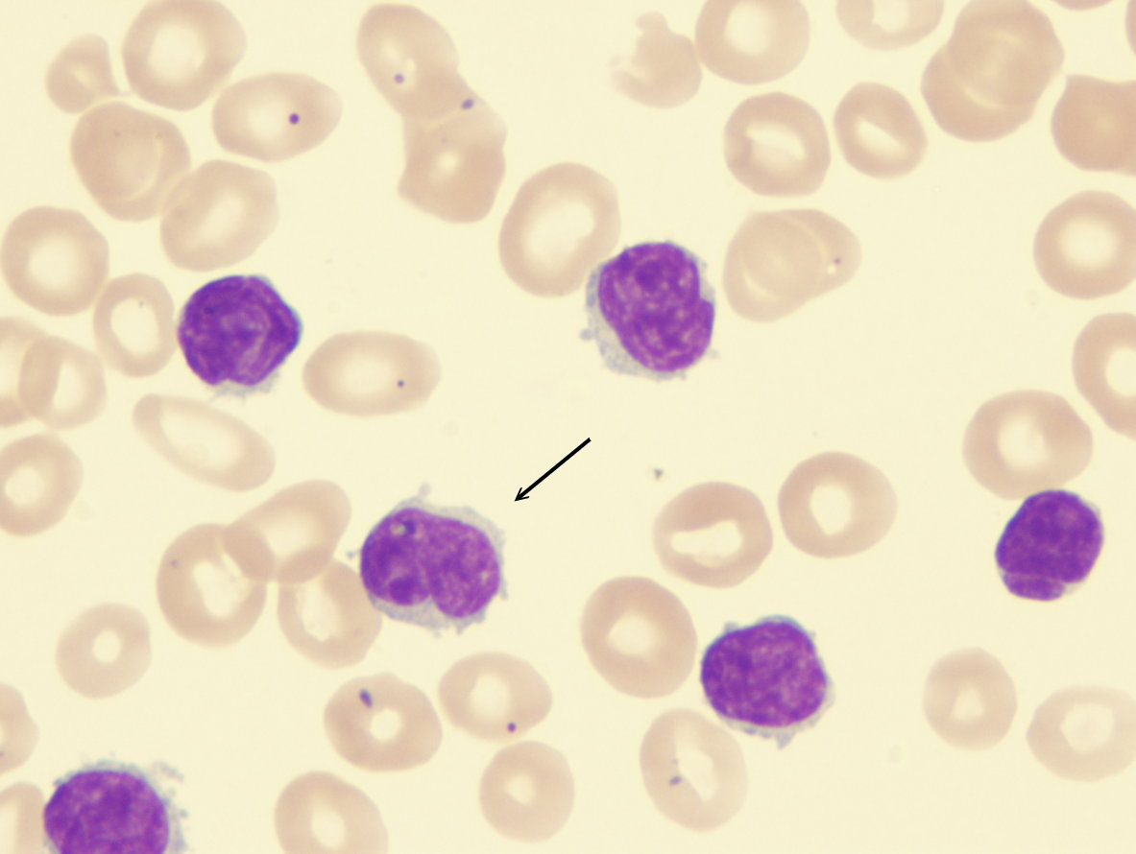
Plasma cells produce immunoglobulins –IgM, IgM, IgG, IgD, IgE.
B cells are responsible for the humoral immunity.

Slide 13
Eosiniphils, Basophils, Mast Cells
Eosiniphils- found in allergic reactions & parasitic reactions.
Basophils- found in hemopoeitic system,
Mast cells -found in tissue.
Both degranulate when stimulated by antigen & release histamin, heparin, vasodialators.

Slide 14
Vascular changes
Injury vasoconstriction vasidilatation
increase the blood flow to the affected area
Increase the vascular pressure, blood flow, cap. permeability

Slide 15
Blood plasma leaks into the tissues
called as
Inflammatory exudate.
Factor XII is released into the exudate
Fibrinolytic system fibrin
limits the inflammation

Slide 16
Leucocytes are attracted by the complement system- chemotaxis
Continuation of the vascular changes lead to the
Increase in blood viscosity
Metabolic changes – decreasein oxygen, increase in co2 levels,lower ph
Detrimental to pulpal metabolism – necrosis of the pulp.

Slide 17
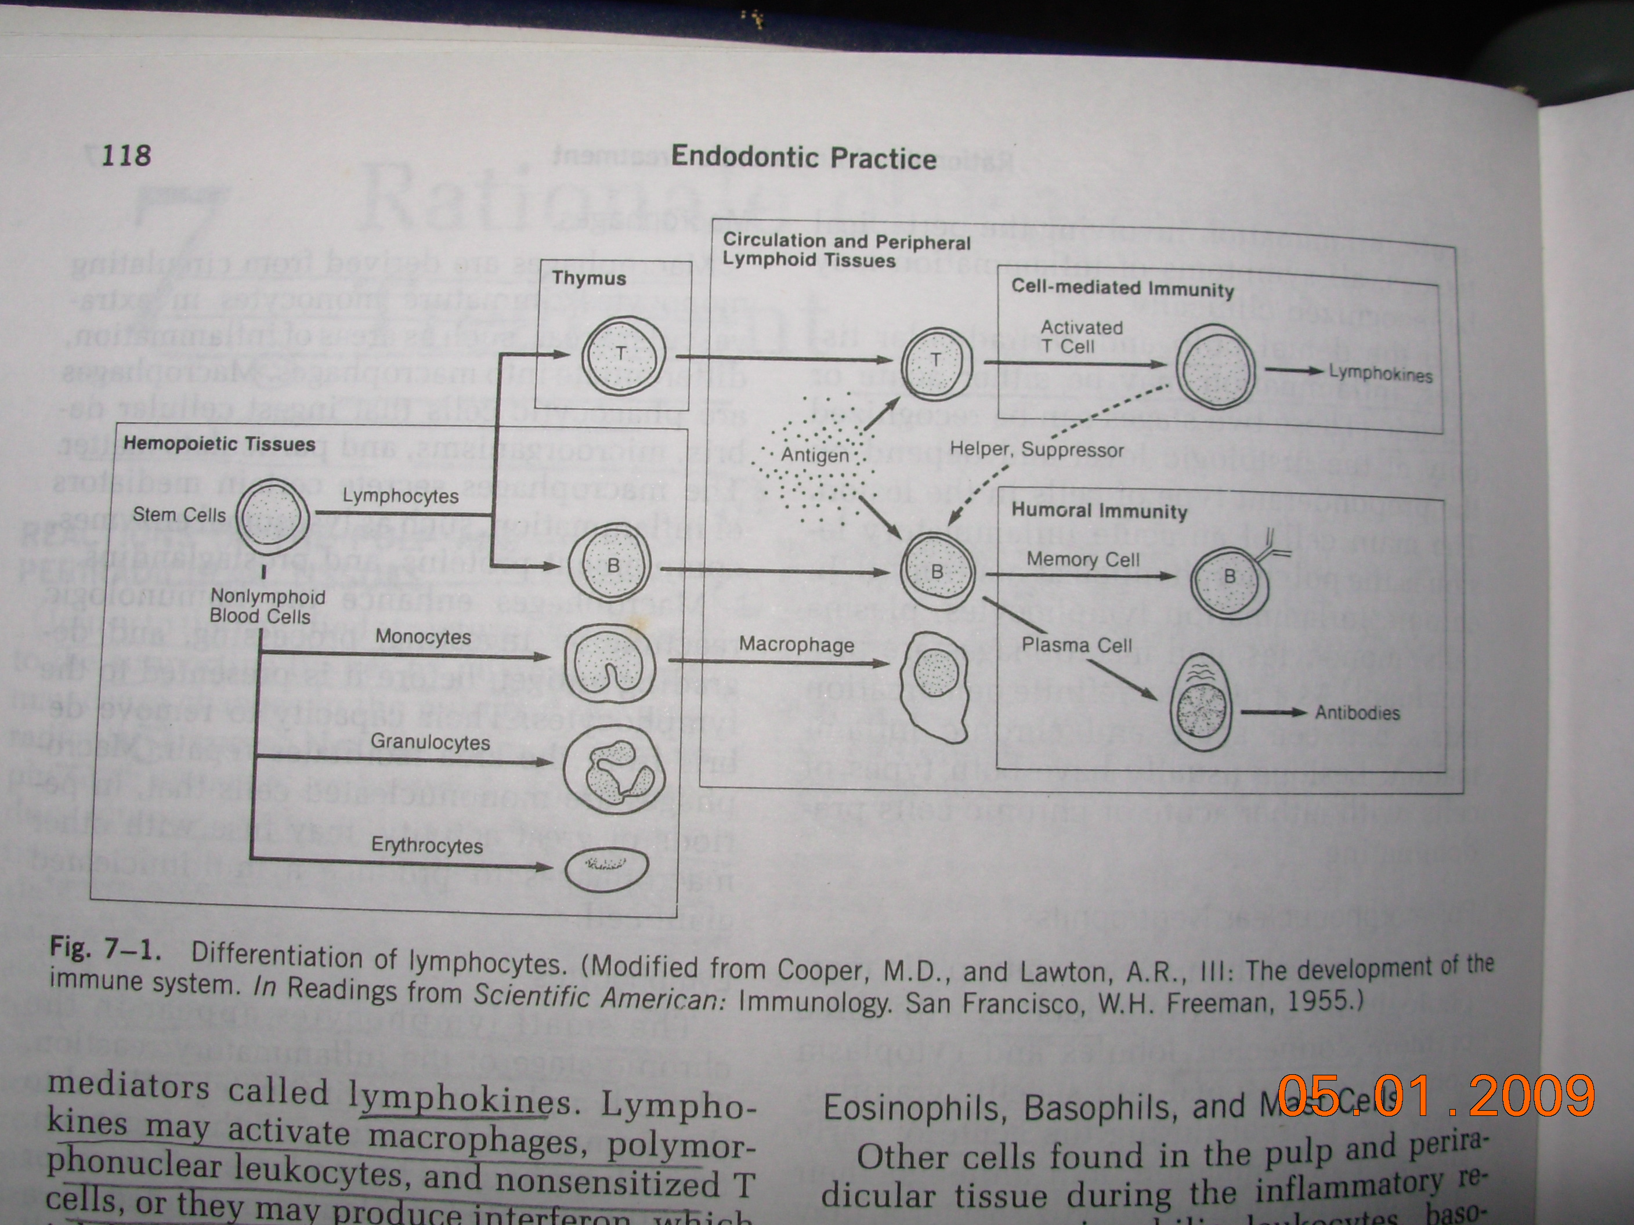

Slide 18
Syngcuk kims hypothetic model

Slide 19
Periradicular manifestation
When inflammatory response overwhelms the pulp with the resulting pulp necrosis, the RC will serve as a pathway to the area for noxious product.
Bone resorption, granulation tissue

Slide 20
Tissue changes after inflammation
Degenrative Proliferative
fibrous / resorptive/
calcific
continues
Necrosis
Another form of degenrative
change is suppuration –
PMNs injured proteolytic enzymes
Lequifaction of dead tissue pus formation/ suppuration

Slide 21
3 requsites for suppuration
Necrosis of tissue cells
sufficient no. of PMNs
Digestion of dead tissue by proteolytic enzymes
Weak irritant exudation consisting of serum, lymph & fibrin serous exudate. An abscess is formed as the enzymes digest the leukocytes & also the adjacent dead tissue, micr- org aren't necessary for the development of the abscess (sterile abscess)

Slide 22
Proliferative changes
Mild irritant acts as stimulants
With in the same area the substance may be both irritant / stimulant eg: calcium hydroxide
In the center of inflammatory area the irritant may be strong to produce degeneration or destruction
In the periphery the irritant is mild to produce proliferation
When the tissue is in apposition- fibroblastic repair
When a gap is present in tissue – granulation tissue( resistant to infection)

Slide 23
The principle cells of repair are fibroblasts,
Laying down cellular fibrous tissue
Destroyed bone is not always replase by new bone but by fibrous tissue

Slide 24
sterile abscess can result from any kind of irritant – physical/ chemical in the absence of micro-org.
Proliferative responses- produced by mild irritants as substance such as CaOH

Slide 25
Repair:
Repair is the return of tissue to normal structure and function and it begins as the tissue becomes involved in the inflammatory process.
Repair of the tissue depends on
1. Severity of injury
2. Host resistance
Reversible damage → Repair
Irreversible damage → Necrosis

Slide 26
Stages of Repair
1. After organization of the blood clot there is formation of granulation tissue.
During this stage the endothelial loops become canalized by the pressure of the blood allowing new channels for circulation of blood.
Anastomosis of these loops occur forming a rich network of small blood vessels.
2. In the soft tissues, development of scar tissue begins fibroblasts grow along fibrin strands and help to form the protein matrix by laying down collagen fibres. After this both the fibroblast and the capillaries become fewer in number and an avascular fibrous tissue i.e. scar tissue is formed.

Slide 27
In bone the process is more complex as soft tissue, has to get converted into hard matrix.
Bone is composed of protein matrix infiltrated by calcium salts like calcium phosphate Ca(PO₄)₂ and calcium carbonate Ca(CO₃)₃. This protein matrix is formed by osteoblasts.
Surrounding the matrix is a fluid subsaturated with calcium salts. The osteoblasts produce alkaline phosphatase which help in forming Ca(PO₄)₂ which gets precipitated as matrix.
There areas or islands in which the Ca(PO₄)₂ is precipitated unite to form spongy trabecular.
Repair always proceeds from periphery towards the center
Therefore to summarise. Granulation tissue------- fibrous connective tissue ----- bone.

Slide 28
Endodontic Implications
Reaction of PR tissue to
Noxious products of tissue necrosis
Bacterial product
Antigenic agents from the RC
HAS BEEN DESCRIBED BY
FISH – described the reaction of periradicular tissue to noxious stimuli , bacterial products , antigens.

Slide 29
A. Zone of infection- PMNs .
infection takes the center of
the lesion, & microorg are
only in that area.

Slide 30
B. Zone of contamination-
Round cell infiltration around the cental zone.
Cellular destruction from the
bacterial toxins from the
central zone.
Lymphocytes were prevalent

Slide 31
C. Zone of irritation-
Macrophages & osteoblasts
Osteoclasts attacked the
bone tissue
Open the gap in the bone
all around the center
of the lesion
Filled with PMNs

Slide 32
D. Zone of stimulation-
Fibroblasts & osteoblasts
Toxins are mild to act as
stimulants

Slide 33
The root canal is the seat of infection
Microorg in the RC are not motile but travel down in the periapical area by proliferation& toxic by products.
When the organisms are sufficiently virulent & over whlem the defence mechanism a periradicular lesion results.
PMNs destroy the organisms as soon as they enter the lesion chronic abscess.

Slide 34
The toxic products of microorg.
Irritating to the periradicular tissue &
With proteolytic emzymes
Released by the dead PMNs
pus formation

Slide 35
When the RC is treated & the reservoir of the bacteria has been eliminated & obturation is done thoroughly, the destroyed bone undergoes repair.

Slide 36
TAKE HOME MESSAGE
Reaction of PR tissue to
Noxious products of tissue necrosis
Bacterial product
Antigenic agents from the RC
HAS BEEN DESCRIBED BY
FISH – described the reaction of periradicular tissue to noxious stimuli , bacterial products , antigens.

Slide 37
QUESTIONS
Describe various ZONES as given by FISH
Stages of repair

Slide 38
REFERENCES
Science Of Dental Materials -----By ANUSAVICE, Skinners.
Restorative Dentals Materials 11th Edition By Craig.
Operative Dentistry 2nd Edition By Summit, Robbins, Schwarts

Slide 39
THANK YOU

